Slide 1
Introduction to Python

Slide 2
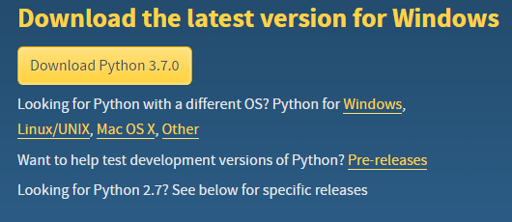
Download Python
Google “download python”
https://www.python.org/downloads/
Windows: click on yellow button “Download Python 3.7.0”
Other: click on your OS below the yellow button, then click “Latest Python 3 Release - Python 3.7.0”
I will be using 3.6.4, 3.7 should be very similar
The development environment “IDLE” should come with python

Slide 3
Open Script
Search for IDLE in your computer and open the desktop app
Here is a terminal - not great for coding programs
Open a script: File > New file
Save file (CRTL + S)
Filename doesn’t matter

Slide 4
Create Function
def HelloWorld():
Notice after you hit “enter” your cursor indents itself
Python tracks methods and loops with indentation - no braces!
Python tracks commands with new lines - no semicolons!
We want to compute 4+6 (type 4+6 inside the function)
Save (CTRL+S)
Run (Run > Run Module) (F5)

Slide 5
Run your script
Type HelloWorld()in the terminal
What happens? - it computes 4+6
Make it print to terminal: go back to script
Use print
Save and Run
Now it prints the output to the terminal

Slide 6
Strings
Defined with ‘ or “: “this is a string” and ‘this is also a string’
In your print statement type a string
If its annoying to retype your function every time you run - put it in the script
Where should it go in the script?
Save and run - you don’t need to do anything in the terminal

Slide 7
Variables
Assigned at runtime - do not declare variables
Create a variable name and set it equal to your name:
name = “my name”
Put your variable in your print statement
Save and run

Slide 8
User Input
We want to get name from user instead of hardcoding it
input(“prompt that will be printed out to terminal”)
Whatever is typed in the terminal is returned in a string
name = input(“What is your name?”)
Save and run

Slide 9
Parameters
Lets pass in the name we want to print out
Delete the input line
Change function definition to include variable: def HelloWorld(name):
Change function call to include parameter: HelloWorld("Megan")
What happens if I try to pass in a number?

Slide 10
Comments
Lets create a new function, called loops
Comment out the line that makes HelloWorld() run automatically
#HelloWorld()
def loops():

Slide 11
For Loops
Lets print 1 through 5 to the terminal
For loops are not like java/c++
for x in range(5):
print(x)
Now how would change it to print what we want?
How to print letters in a name?

Slide 12
Lists
Lists are like arrays (0-indexed)
Comment out our old function calls
Create a new function list()
pets = ["cat", 'dog',"fish"]
numbers = [1,2,3]
items = [‘cat’, 2, “cow”]
Print list: print(items)
You can have lists of lists:
L1 = [‘cat’, [3,2], “fish”]
L2 = [L1, [3,2,1], “cow”]
How to access ‘fish’ from L2?
fish = L2[0][2]
How to set [3,2,1] to ‘dog’ in L2?
L2[1] = ‘dog’

Slide 13
While Loops
Similar to java/c++
Print out all items from the list individually
while i < len(items):
print(items[i])
i = i + 1

Slide 14
Questions?

